Slide 1


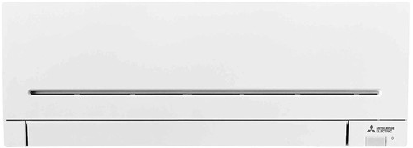
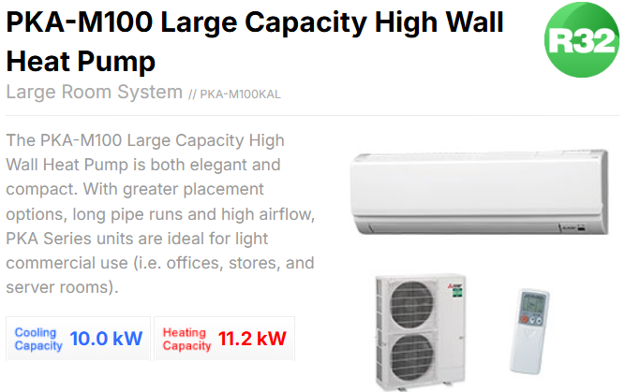

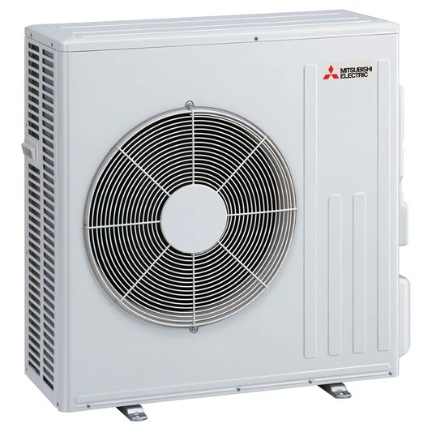
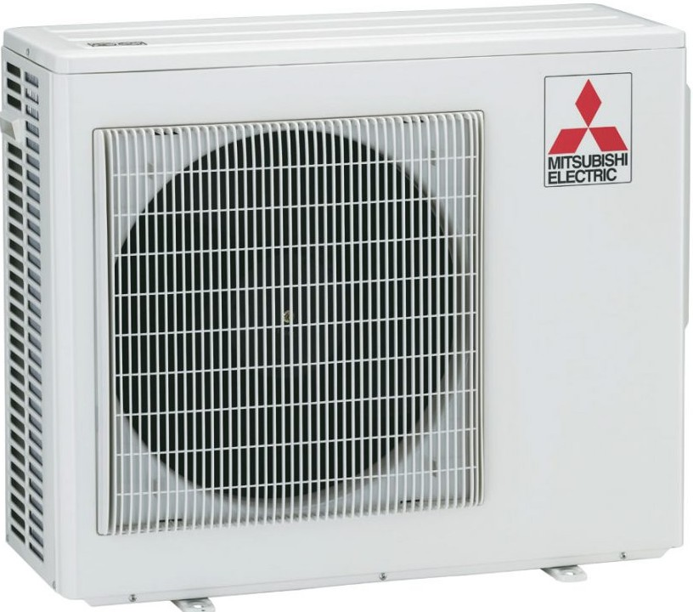
AP Mini High Wall
PKA Series units are ideal for light commercial use!
Cooling: 10.0 kW
Heating: 11.2 kW
Installation Included

